Slide 1

SM 300 PROJECT
GROUP NO 9
Anurag(211EE215)
Kamaldeep(211EE232)
Madhav(211EE237)
Rohit(211EE248)
Sujal(211EE259)

Slide 2


VENDISTORES
BECOMING SHOPOMATIC

Slide 3
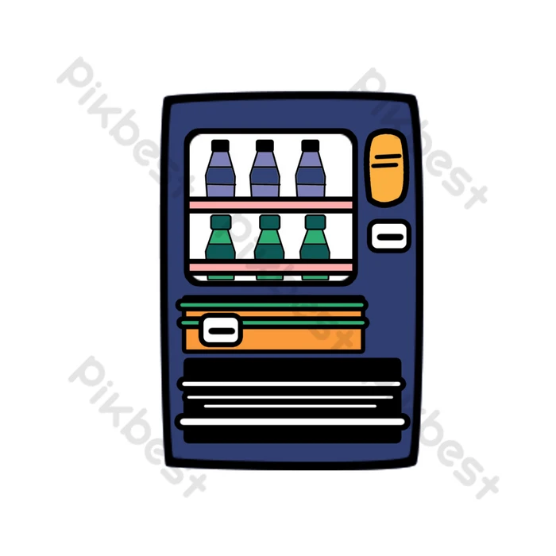
INTRODUCTION
The idea aim is to promote the unmanned retail segment in India. It is a shop without a shopkeeper a “Vending Machine”.It is a business model that has skyrocketed in the west and the aim is to expand the same in India.

Slide 4

There are approximately 65 lakh potential locations across about 500 cities in India where vending machines can be installed. With around 40,000 hospitals, 5,55,000 workplaces, 1,13,000 public places (metro and railway stations, etc.), 2,49,000 factories, 2,20,000 ATM locations, and 6,30,000 residential areas (apartments, PGs, hostels), the estimated market size in the Indian market is about 14 billion USD.
Market
RESEARCH

Slide 5

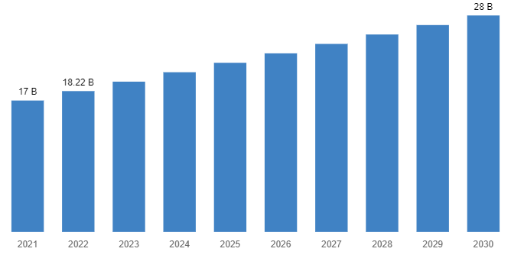
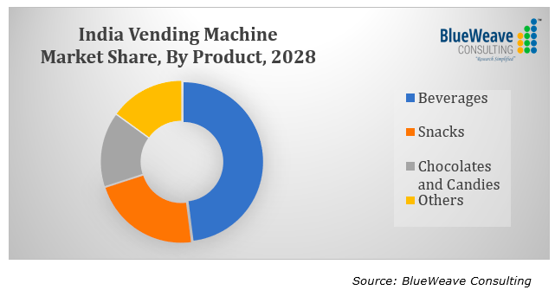
Market
TRENDS
The global market size of this as of 2022 is 18.22 billion and it will rise to about 28 billion by 2030. . It is well-established in the US, Japan, and Europe. On the other hand, it is still in a growth phase in the Asian countries especially India.

Slide 6
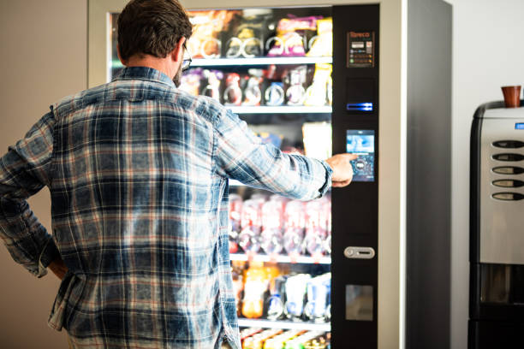

CONVENTIONAL
MARKET
The traditional marketplaces in India are such that you go to a shop, tell the shopkeeper what you want and it is given to you.What we wish to do is that we wish to remove the shopkeeper in between , so that it is just the consumer and the commodity.

Slide 7
USER CONVENIENT
LOW OVERHEAD COST
TIME SAVING
EFFECTIVE ADVERTISEMENT PLATFORM
24/7 365 DAYS SERVICE
SAVES MANUAL LABOUR
ADVANTAGES

Slide 8
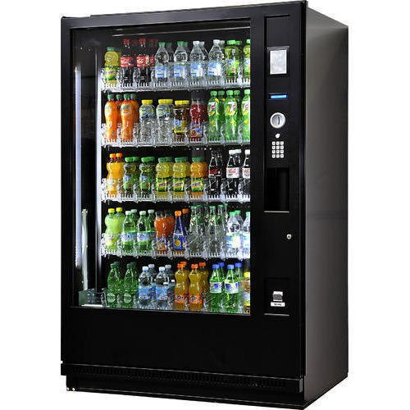
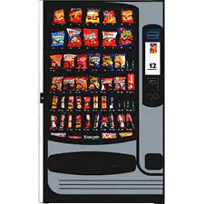
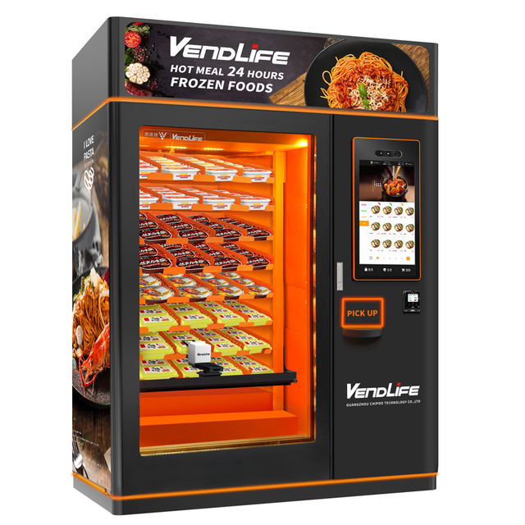
PRODUCTS
Beverages
Snacks
Frozen Foods

Slide 9
CUSTOMER CARE
& SERVICES
Prompt customer care services will be provided which would clarify all issues faced by the consumers. The vending machine would be refiled regularly so that there is not a shortage of any products.

Slide 10
Target 1
our first target is to introduce 100 machines into the market
Target 2
reaching a PAN India level in this field while expanding to other markets places and start generating revenue from advertisements as well
Target 3
reaching a global level by first introducing these product in the inidan subcontinent region.

Slide 11

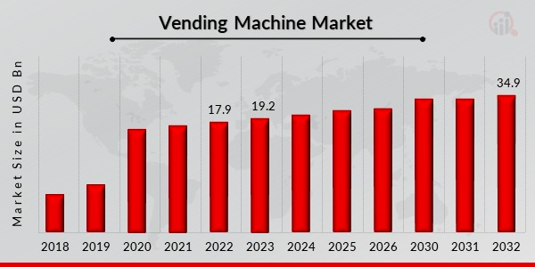
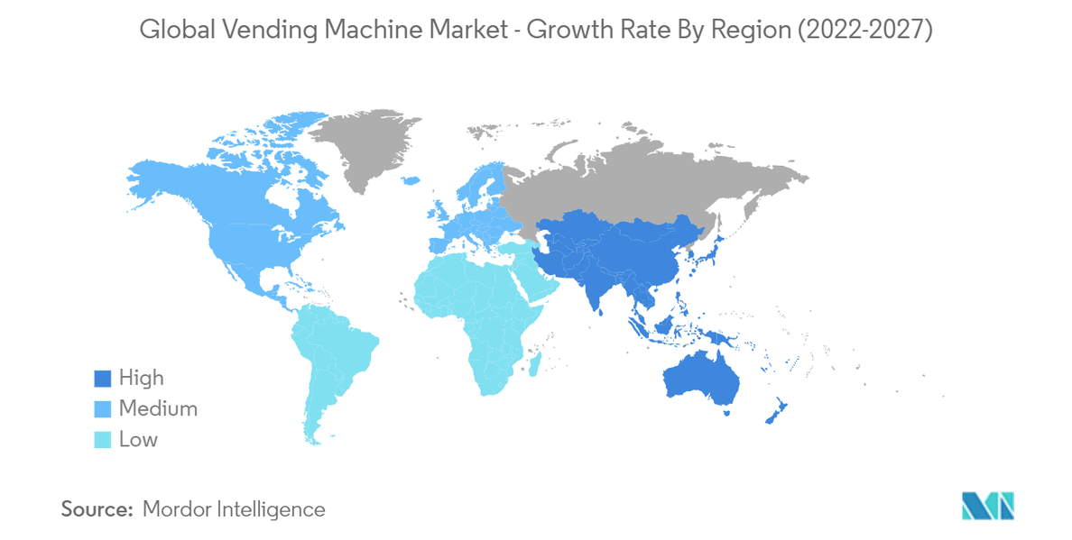
DEMAND
FORCAST
India's Vending Machine Market is projected to grow at a CAGR of 17.2% during the forecast period (2022-2028)
GLOBAL DEMAND LOCATONS
Although North America is the largest market as of today but Asia region has the highest potential and the growth rate for demand in upcoming years

Slide 12
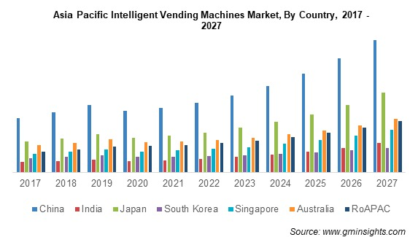

Slide 13
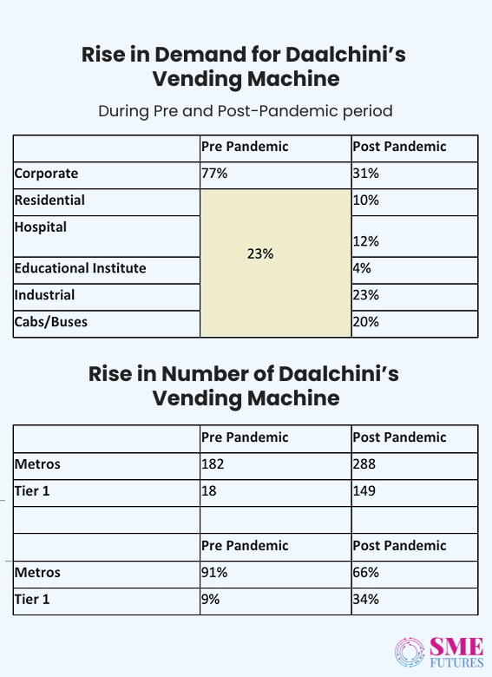

Slide 14
Procurement
Warehousing
We will be outsourcing the machine from the prominent manufacturers of the city in which we are operating. In the case of Mumbai we will be taking from DALCHINI
As we will be starting business in mumbai we will have our warehousing facility in bhiwandi which is already a warehousing hub.

Slide 15
SEED
INITIAL INVESTMENT 3.5CRS
2cr -buying initial 100 machines
24lakhs-insurance for the initial machines
20lakhs-buying office furnitures ,laptops,
20k-licenses
90lakhs initial inventory
17lakhs -reserve funds
FUNDING
Our business would be based on a bottstrap model.

Slide 16

MONTHLY REVENUE
FOR EXPECTED SALES OF 4000 PER DAY FOR 100 UNITS
SALES- 1.2CR
LOCATION RENT- 4LACS
INVENTORY COST - 90LACS
WAREHOUSE/OFFICE RENT - 3LACS
OPERATIONAL EXPENDITURES- 4LACS
EMPLOYEE SALARIES - 10LACS
ADVERTISEMENT - 2LAKS
NET PROFIT- 7LACS

Slide 17
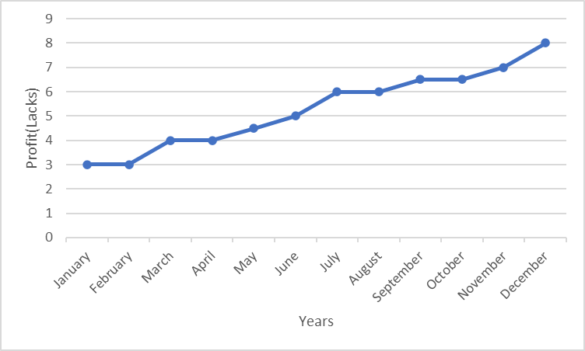
The mentioned graph depicts the first year profits monthwise which sum up to about 84 lakhs,with an average profit per month being 7 lakh which is the net profit after cuttting all expenses.

Slide 18
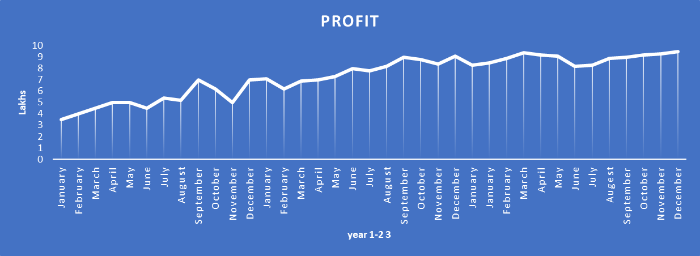
Thi s particular graph corresponds to the profits made in the first three years month wise ,we see gradual but steady
increase in the profits made as we reduced our variable costs with time.
With this trend it will take about 4 years of time to have a 100% ROi.

Slide 19
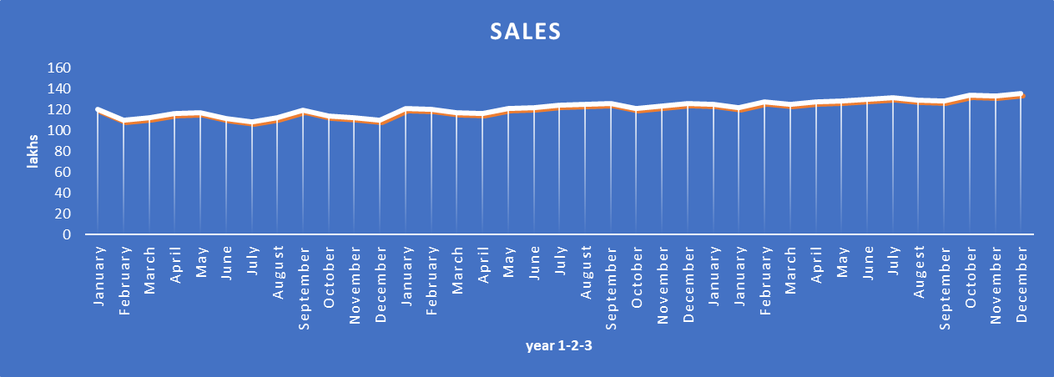
The above graph shows the sales trend over the first three years monthwise ,the sales would be stable during this time as we do not move any expansion during this time .
Once the firm ground is made after three years we will also be generating revenue by running adss through our machine .

Slide 20
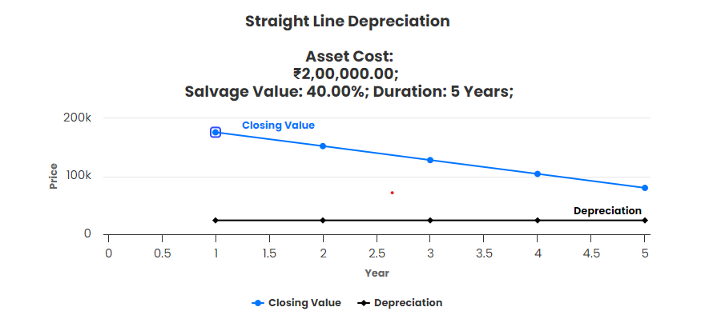
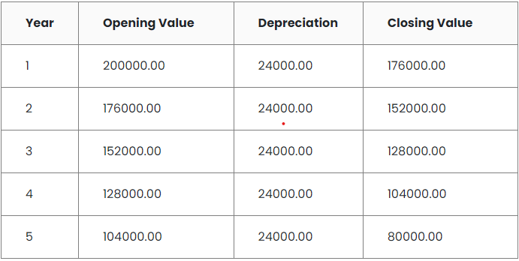
Depreciation
1.Straight Line Depreciation:
A depreciation was applied on the machine its initial price bieng 2lakhs and salvage being 80k at the end of 5 years.the closing value constantly decreases by 24000 each year.

Slide 21
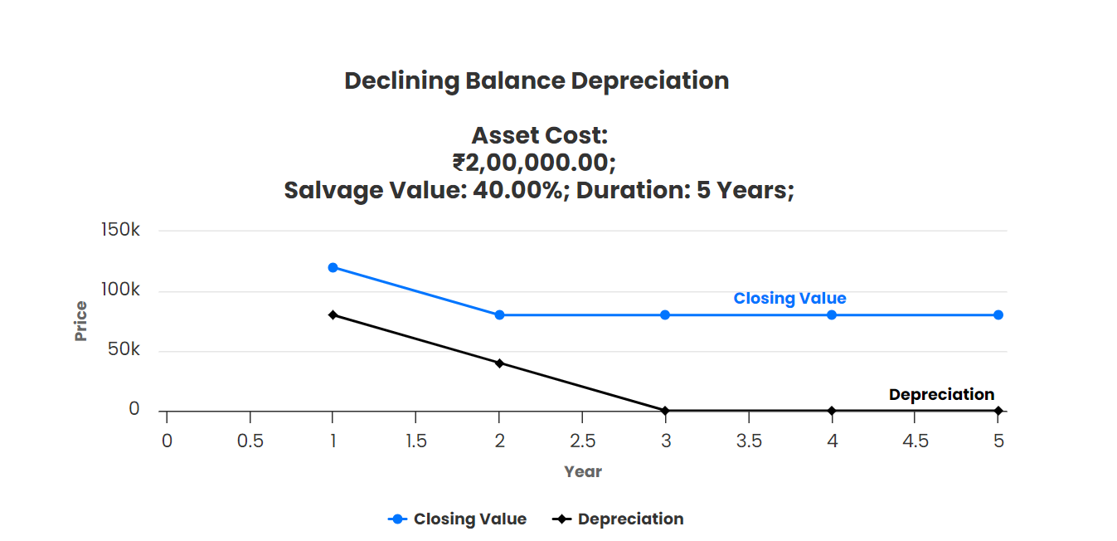
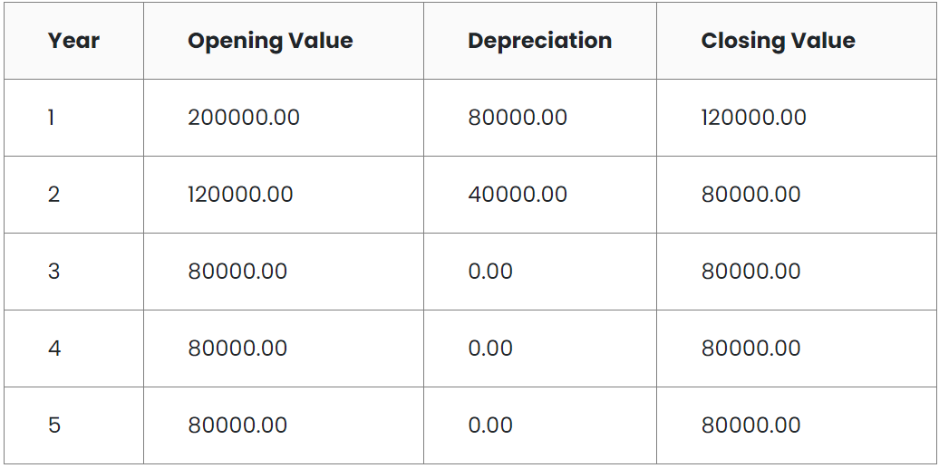
Depreciation
2.Declining Balance
A depreciation was applied on the machine its initial price bieng 2lakhs and salvage being 80k at the end of 5 years. closing value at end of the first is observe to be 120000.

Slide 22
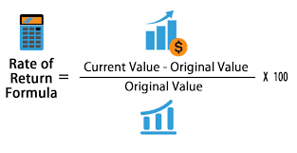
Rate of Return
Current rate of inflation as 5%.
Calculated as the percentage gain or loss on an investment relative to its initial cost or outlay.
Current value: ₹4,46,69,855
Initial Investment:₹35000000
Nominal Rate:13.40%
Real Rate:8.00%
Inflation Rate:5.00%

Slide 23
TIMELINE
YEAR 1-4
YEAR 4-10
YEAR 10-12
YEAR 12+
Initial inception with top colleges and schools across Mumbai and Pune. and recovering seed money and start making profits
Once we are more established we will expand to other cities and marketplaces .also expanding to palces like clubs,hospitals etc.also start earning from advertisements
This will be our expansion phase where we will innovate our products and diversify our operations even more
In this phase, we will start our operations in the neighboring countries of India like Bangladesh,Sri Lanka,Nepal, Bhutan etc.

Slide 24

EXPANSION
PLANS
Once we are a pioneer in the field of vending machine market in India.we will work on different products such as a sanitary napkin vending machine. A major part of this business would be a B2G business model. We will also start operations in neighbouring countries like Nepal, Bhutan ,Bangladesh.

Slide 25

Anurag(211EE215)
Kamaldeep(211EE232)
Madhav(211EE237)
Rohit(211EE248)
Sujal(211EE259)

